Slide 1



Wayanamac Education Trust®
DON BOSCO INSTITUTE OF TECHNOLOGY
Kumbalagodu, Mysuru Road, Bengaluru – 560074
(An Autonomous Institution under VTU, Accredited by NBA & NAAC with ‘A’ Grade Approved by AICTE, New Delhi, Recognized by Govt. of Karnataka)
Department of Computer Science & Engineering
www.dbit.co.in cse@dbit.co.in Ph: +91-80-28437028 / 29 / 30 (Extn. 131)
AutoSecAudit
A Multi-Tool Framework for Automated Security Auditing of Web Applications
Submitted by:
Under the guidance of:
KODI VISHRUTH AITHAL : 1DB23CS104
RANJITHA R
THILAK N : 1DB23CS229
Assistant Professor
VINAYA KUMAR B : 1DB23CS244
Dept of CSE
VISHAL GOWDA B : 1DB23CS246

Slide 2
Table of Contents
01 Abstract
02 Introduction
03 Problem Statement
04 Objectives
05 Literature Survey
06 Proposed Model
07 System Design
08 Languages & Tools Used
09 Implementation
10 Conclusion
11 References

Slide 3




Abstract
Rapid Development Challenge
AI-assisted tools accelerate web app development but often overlook security validation, leaving applications vulnerable to cyber threats
Common Vulnerabilities
Insecure configurations, exposed services, improper authentication, outdated components remain undetected without proper security auditing
Proposed Solution
Automated security audit framework integrating multiple scanning tools with modular architecture for centralized analysis and reporting
Multi-Tool Security Framework
Centralized Vulnerability Detection

Slide 4







Introduction
Digital Infrastructure Era
Web applications form the backbone of modern digital services across e-commerce, banking, healthcare, and enterprise systems
Project Objective
Design automated security audit framework integrating multiple scanning tools with modular architecture for future extensibility
Development Evolution
AI-assisted coding tools and rapid development frameworks accelerate deployment but often introduce security challenges due to insufficient testing
Common Vulnerabilities
Open Network Ports
Misconfigured Servers
SQL Injection
Cross-Site Scripting
Insecure Authentication
Outdated Libraries

Slide 5






Problem Statement
Rapid Development vs Security Gap
AI-assisted tools accelerate development but inadequate security testing leaves applications vulnerable
Need for unified automated framework integrating multiple tools with clear, structured security reporting
Deployment Without Assessment
Applications deployed without comprehensive vulnerability checks due to time constraints and lack of expertise
Complex Technical Output
Existing scanning tools generate large volumes of technical data difficult for developers to interpret and prioritize
Fragmented Tool Landscape
Multiple tools operate independently, requiring manual analysis and result consolidation

Slide 6

Objectives
01
Automated Framework Development
02
Vulnerability Detection
Design and develop automated framework for performing security audits on web applications
Detect common vulnerabilities in a rapidly developed web applications and system configurations
03
Tool Integration
04
Data Consolidation
Integrate multiple security scanning tools within unified framework to improve detection coverage
Collect and consolidate security findings from different tools and organize results for analysis
05
Severity Analysis
06
Structured Reporting
Analyze detected vulnerabilities and classify them based on severity and potential impact
Generate structured security audit reports with clear descriptions and recommended mitigation strategies
07
Modular Architecture
Design framework in modular manner to enable future integration of additional security tools and analysis techniques

Slide 7
Literature Survey
Author & Year | Title | Key Contribution | Relevance to Project | Limitations
Akinyemi et al. (2025) | Role of AI in Modern Cybersecurity Vulnerability Management Practices | AI and ML improve threat detection and automation | Highlights importance of automation in security | Focuses more on concepts than implementation details
Daniel et al. (2025) | A Systematic Review of AI-Driven Automated Software Vulnerability Detection Systems | AI-based vulnerability detection using ML techniques | Demonstrates intelligent detection potential | Review-based study without practical framework development
Sonawane et al. (2025) | Practical Vulnerability Detection Using Wireshark, Nmap, Metasploit | Combines multiple security tools for testing | Supports multi-tool integration approach | Requires manual penetration testing knowledge
Seara et al. (2024) | Automation of System Security Vulnerabilities Detection Using Open-Source Software | Automated scanning and report generation | Foundation for automated security scanning | Limited support for advanced vulnerability analysis
Aumpansub et al. (2021) | Detecting Software Vulnerabilities Using Neural Networks | Neural network-based vulnerability detection | Shows automation improves detection accuracy | Accuracy depends on training dataset quality

Slide 8






Proposed Model
Input Module
Scanning Module
User interface for providing target web application URL or server address to initiate security audit
Automated vulnerability scanning to identify security weaknesses like open ports and misconfigurations
Tool Integration Layer
Data Collection Module
Modular interface supporting multiple security tools for different vulnerability detection types
Gathers and organizes vulnerability information from multiple tools in structured format
Analysis Module
Report Generation Module
Processes vulnerability data, filters duplicates, categorizes by severity, and prioritizes critical issues
Produces structured security audit reports with vulnerability details and mitigation strategies

Slide 9






System Design and Architecture
Layered Architecture with Interconnected Modules
User Interface Layer
Security Scanning Engine
Interaction point for users to provide target address and view security audit reports
Executes automated vulnerability scanning and coordinates multiple security analysis tools
Tool Integration Layer
Data Processing & Storage
Bridge between framework and various security scanning tools with extensible design
Collects, standardizes, and stores vulnerability data in structured format
Vulnerability Analysis Module
Report Generation Module
Removes redundant entries, categorizes vulnerabilities by severity, and prioritizes critical issues
Produces structured security audit reports with vulnerabilities and mitigation strategies

Slide 10
Languages & Tools Used
01
Programming Languages
02
Security Tools Integrated
Python 3.10+ - Primary language
Nmap - Port scanning & service detection
Nikto - Web vulnerability scanning
03
Frameworks & Libraries
04
External APIs
Flask - Web UI framework
Jinja2 - HTML template engine
Requests - HTTP API calls (CVE enrichment)
PyYAML - Configuration
NVD API - CVE data & CVSS scores
CIRCL API - CVE enrichment
05
DevOps Tools
Docker - Containerization
Docker Compose - Multi-service orchestration
GitHub - Version control

Slide 11
Implementation
02
Key Features
Architecture: Input Module → Plugin System → Intelligence Layer → Reports
Plugin-based extensible architecture
Parallel scanning with ThreadPoolExecutor
Mock mode for demo
Delta…comparison between scans
Automated OWASP compliance mapping
01
Components Built
Module | Purpose
Base Plugin | Common base for all scanners
Core Engine | Executes multiple scans simultaneously
Nmap Plugin | Detects open ports and services
Nikto Plugin | Finds website security vulnerabilities
Correlator | Organizes related vulnerability findings
Enricher | Adds CVE and threat details
Compliance | Maps issues to OWASP Top 10
Delta | Compares current and previous scans
Report Generator | Generates detailed HTML security reports
Web UI | Provides user-friendly Flask interface
03
Project Structure
AutoSecAudit/
main.py # CLI
core/ # Engine & models
plugins/ # Scanners
intelligence/ # Analysis
reports/ # Generator
ui/ # Flask app
Dockerfile
docker-compose.yml

Slide 12
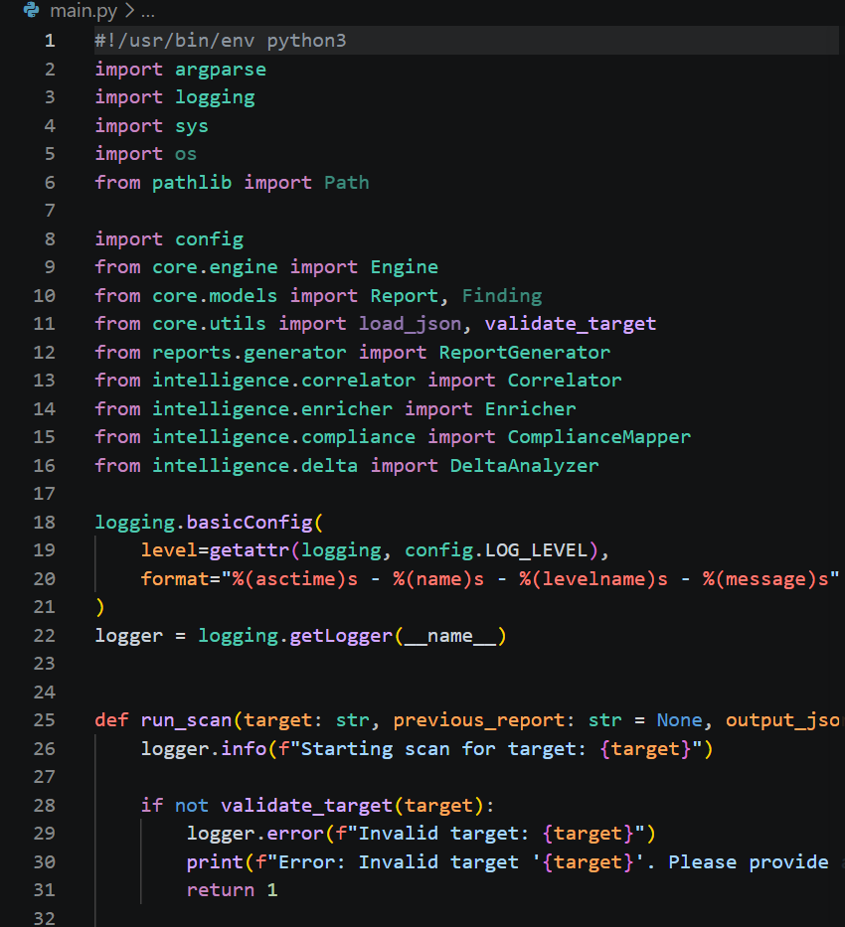
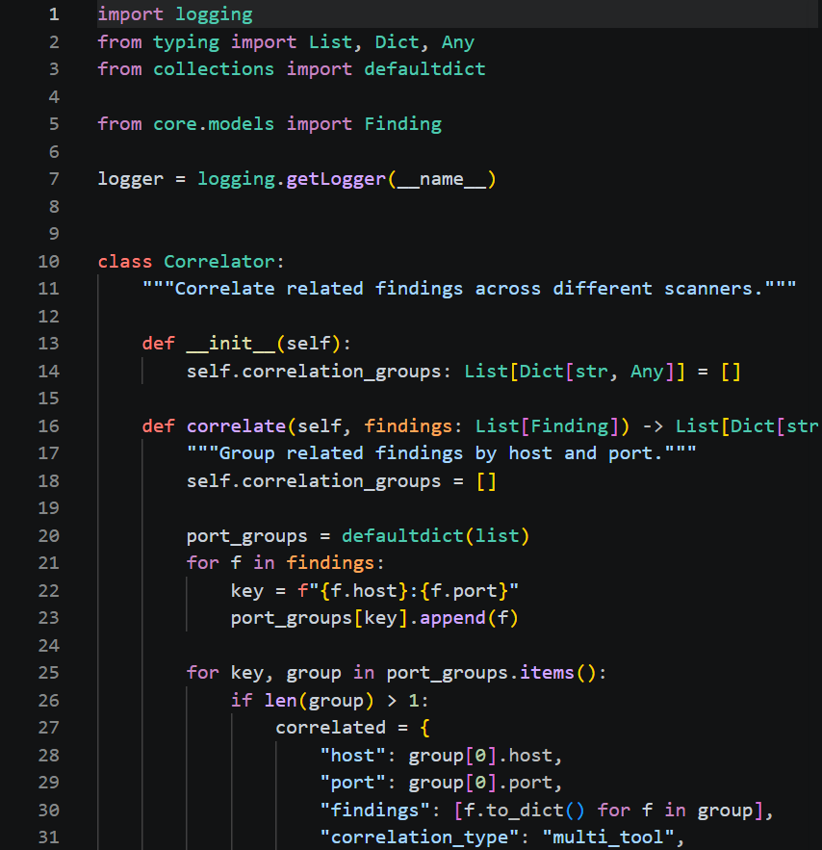
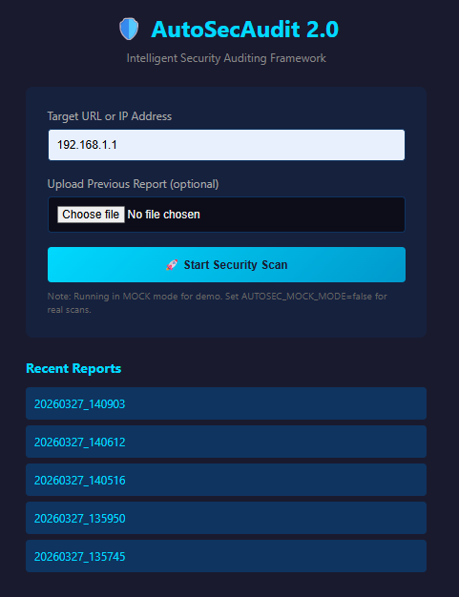
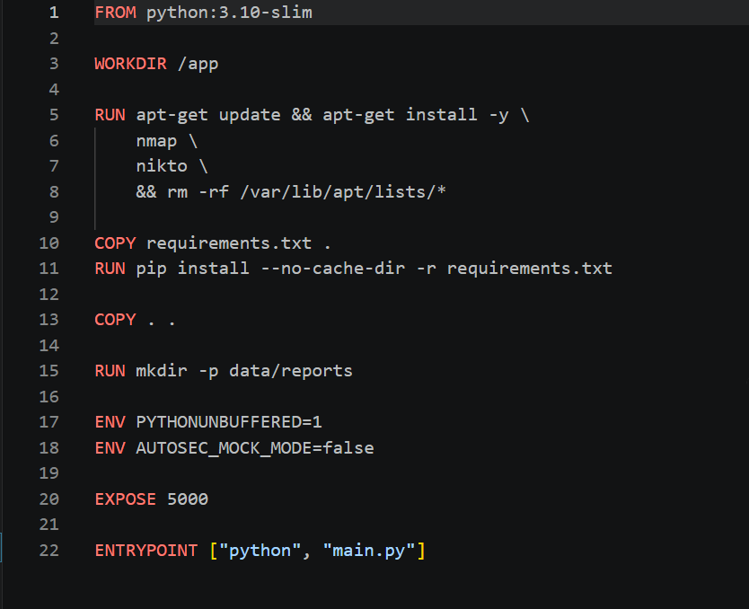
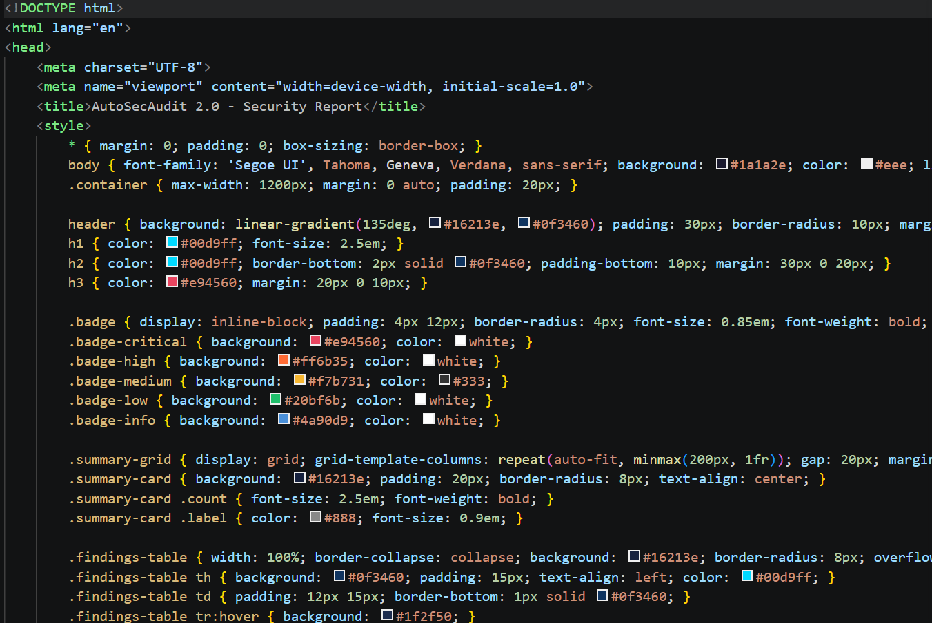

Slide 13
Conclusion
01
02
Developed an automated web security auditing framework for web applications
Integrated multiple security scanning tools into one platform
03
04
Detected common web application vulnerabilities automatically and efficiently
Generated centralized and structured security audit reports clearly
05
05
Improved vulnerability analysis, organization, and risk management process
Designed the framework for future scalability and feature enhancements

Slide 14
References
[1] A. M. Akinyemi and S. Sims, “Role of Artificial Intelligence in Modern Cybersecurity Vulnerability Management Practices,” World Journal of Advanced Research and Reviews, vol. 26, no. 1, pp. 555–584, 2025.
[2] V. T. Daniel, B. Fawei, and B. R. Japheth, “A Systematic Review of AI-Driven Automated Software Vulnerability Detection Systems,” International Journal of Computer Science and Mathematical Theory, vol. 11, no. 12, pp. 98–116, 2025.
[3] D. Sonawane, A. Ali, S. Rajput, S. Kushwaha, and A. Rane, “Practical Vulnerability Detection and Penetration Testing Using Wireshark, Nmap, and Metasploit,” International Journal of Creative Research Thoughts, vol. 13, no. 12, pp. b583–b590, 2025.
[4] J. P. Seara and C. Serrão, “Automation of System Security Vulnerabilities Detection Using Open-Source Software,” Electronics, vol. 13, no. 5, pp. 1–24, 2024.
[5] A. Aumpansub and Z. Huang, “Detecting Software Vulnerabilities Using Neural Networks,” in Proc. 13th International Conference on Machine Learning and Computing (ICMLC), 2021, pp. 166–171, 2021.

Slide 15
THANK YOU

